Slide 1

Wound Healing and Immune Response
Louisiana Tech University
College of Engineering and Science
BIEN 235
Dr. Teresa Murray

Slide 2
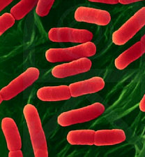
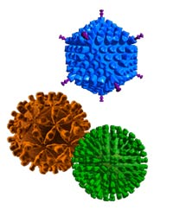
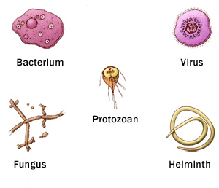
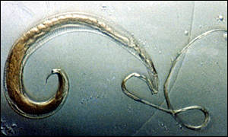
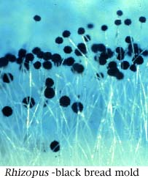
Louisiana Tech University
College of Engineering and Science
Infectious agents activate the immune system
trichura.jpg harvard outreach
Adapted from www.sdnhm.org/exhibits/epidemic/teachers/background
www.mayoclinic.com/health/medical/IM03966
Adapted from www.hhs.gov.asphep/presentation/images.jpg

Slide 3
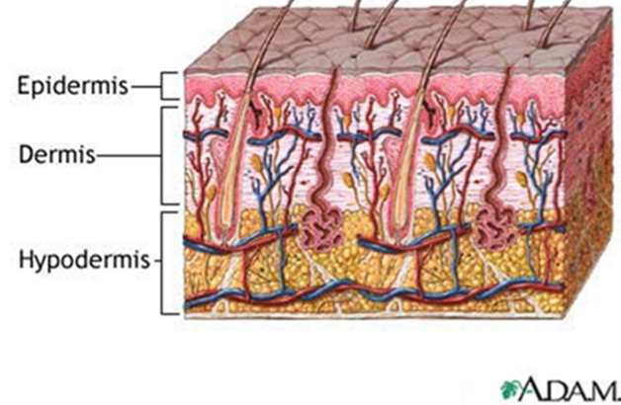
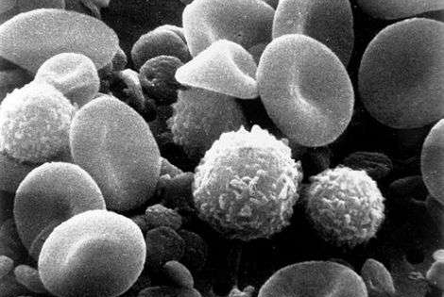
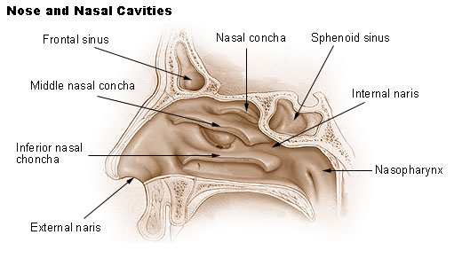
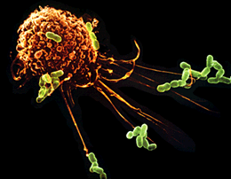
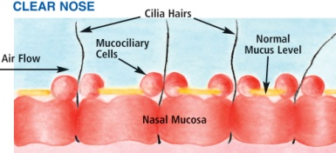
Louisiana Tech University
College of Engineering and Science
Keeping infectious agents out, or destroying them
White blood cells in blood
www.lestout.com
www.associatedcontent.com
http://www.web-books.com/eLibrary/
Macrophage and bacteria
http://www.fess.com.au
www.mansfield.edu
Notes:
BELOW: Quoted from Immunology: Lympocyte and Leukocyte White Blood Cells by Tami Port, MS, online 2/7/2010 from
http://www.associatedcontent.com/article/2255385/cells_involved_in_the_human_immune.html?cat=5
“Immunology: Lymphocyte and Leukocyte White Blood Cells
The human immune system is composed of three lines of defense, each with different barriers, cells and chemicals that protect us from infection. The first and second lines of immune defense are nonspecific, meaning that they do not target specific pathogens (microbes that cause disease), but instead provides general protection against all invaders. The second line of immune defense comes into play when pathogens succeed in getting into the body by penetrating the skin or mucous membranes. The components of this second line of defense consist of cells, antimicrobial chemicals, and processes, but no physical barriers. Many components of second line defense are contained, or originate, in the blood, including most of the white blood cells, also known as leukocytes.
Blood and the Immune System Blood is composed of cells and portions of cells within a fluid medium called plasma. Plasma is mostly water, but also contains electrolytes, dissolved gases, nutrients, and proteins. The cells and cell fragments in plasma are called "formed elements", and include red blood cells and platelets. There are three types of formed elements: 1. Erythrocytes - red blood cell, which carry oxygen & carbon dioxide in the blood 2. Platelets - which are involved in blood clotting 3. Leukocytes - white blood cells involved in defending the body against invaders Types of Leukocytes Leukocytes can be divided into two main groups: 1. Granulocytes 2. Agranulocytes Granulocytes These white blood cells are characterized by the presence of granules (small particles that are easy to stain and see under a microscope) in their cytoplasm.
There are three types of Granulocytes: 1a. Neutrophils: These are the most abundant type of white blood cell, and the predominant cells in pus, accounting for its whitish appearance. Neutrophils react within an hour of tissue injury and are the hallmark of acute inflammation. 1b. Basophils: These are the least common granulocyte. When activated, basophils release histamine, proteoglycans (e.g. heparin and chondroitin), and proteolytic enzymes, all of which contribute to inflammation.
1c. Eosinophils: These cells primarily play a role in fighting viral infections, and are also considered to be the the main effector cells in allergic responses and asthma. Eosinophils also fight helminth (worm) colonization. Neutrophils and Eosinophils can phagocytize (engulf and digest) pathogens whereas Basophils release chemical that help us fight infection. Agranulocytes These white blood cells are distinguished by the absence of granules in their cytoplasm. There are two types Agranulocytes: 2a. Lymphocytes: Primarily involved in the third line of immune defense; specific immunity. 2b. Monocytes and Macrophages: Macrophages are phagocytic cells of the second line of defense. They ingest and destroy foreign matter such as microorganisms or debris via a process known as phagocytosis. Macrophages originate in the bone marrow as Monocytes, and are called Macrophages once they migrate to the organs. Macrophages come in two varieties. Wandering macrophages leave the blood and phagocytize throughout the body, while fixed macrophages do not move throughout the body and often phagocytize within a specific organ.” Sources: Bauman, R. (2005) Microbiology. Pearson Banjamin Cummings.; Park Talaro, K. (2008) Foundations in Microbiology. McGraw-Hill.”

Slide 4
Overview
Part II MEDICAL
Chap 19 Body-Biomaterials
Immune system
Two types of cells of immune system, and their defense roles
Wound healing
The wound healing process of skin and bone
Cellular activity of inflammation phase
Systemic reaction
Body long-term responses to implants

Slide 5
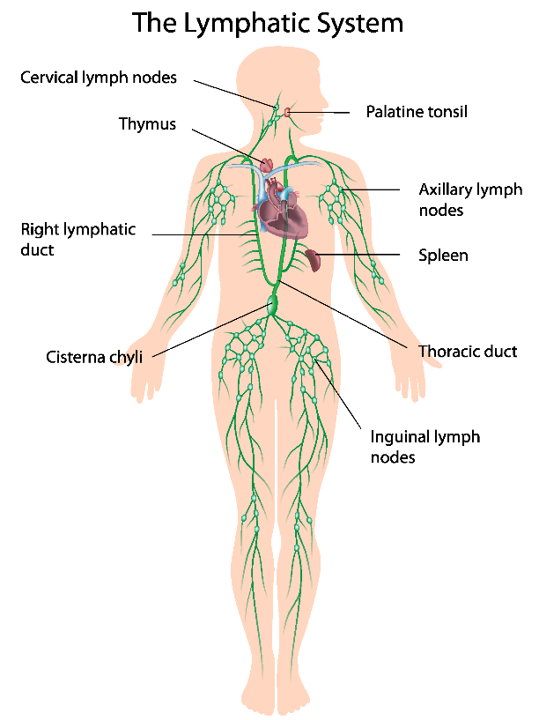
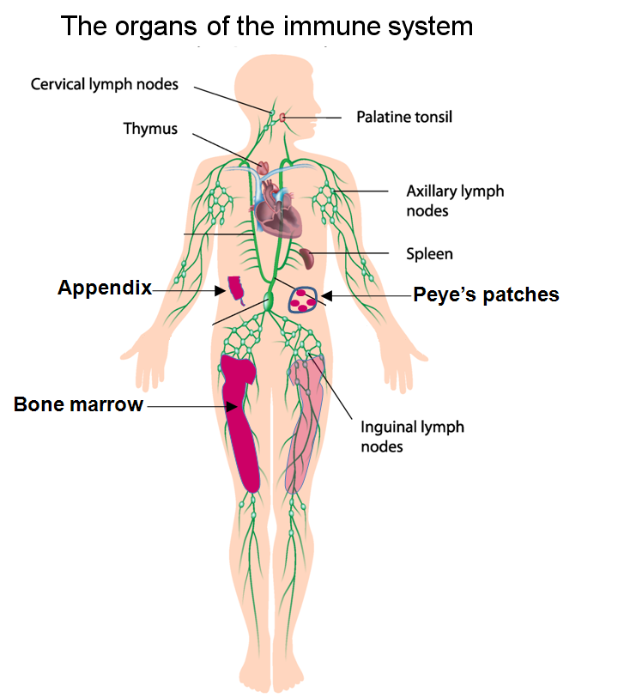
Immune and Lymphatic System
Part II MEDICAL
Chap 19 Body-Biomaterials
The immune and lymphatic systems are two closely related organ systems that share several organs and physiological functions.

Slide 6
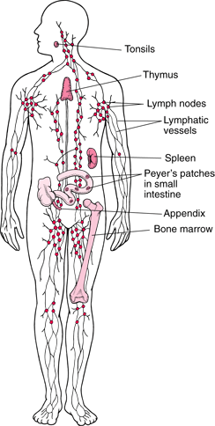
Lymphatic & Immune System
Louisiana Tech University
College of Engineering and Science
System of vessels and organs
B-cells and T-cells made in bone marrow, migrate to the lymphatic system.
B-cells later migrate into the blood circulatory system.
Lymphatic system www.merck.com/mmhe

Slide 7
Cells of Immune System
Part II MEDICAL
Chap 19 Body-Biomaterials
The immune system is is made up of a network of cells, tissues, and organs that work together to protect all other tissues in the body, linked via the blood and lymph vessels
The cells involved are the white blood cells (leukocytes), which originate in the bone marrow, but are stored in many locations in the body, including the thymus, spleen and lymph nodes, collectively called the lymphoid organs.

Slide 8
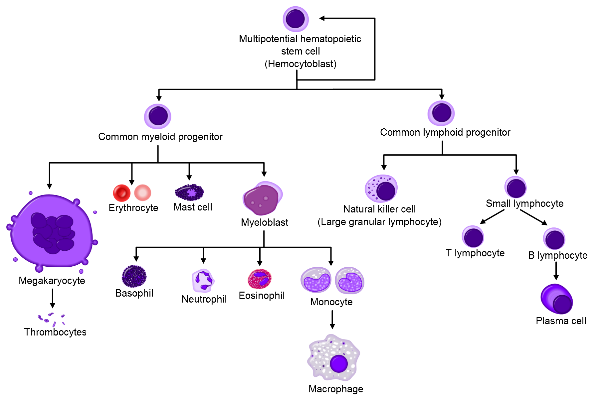
Cells of Immune System
Part II MEDICAL
Chap 19 Body-Biomaterials

Slide 9
Antigen and Antibody
Part II MEDICAL
Chap 19 Body-Biomaterials
In immunology, an antigen (Ag), or antibody generator, is any substance which provokes an immune response in the body.
An antigen is often foreign or toxic to the body (for example, a bacterium) which, once in the body, attracts and is bound to a respective and specific antibody.

Slide 10
The Immune System
Part II MEDICAL
Chap 19 Body-Biomaterials
The immune system is the defence system against infectious organisms (such as bacteria, viruses) and foreign materials.

Slide 11
Two Sub-Systems of Immune System
Part II MEDICAL
Chap 19 Body-Biomaterials
Innate immune system: the first line of defence, based on a learned or pre-programmed, non-specific reaction to foreign bodies.
Adaptive or acquired immune system: where a new foreign stimulus has been encountered, creating a molecular “memory”, which is stored in the case of a later repeated event.

Slide 12

Innate and adaptive immunity
Some Innate Cells
Neutrophils
1st to arrive
Phagocytosis
Proteases
Macrophages
Arrive 2nd
Phagocytosis
An antigen presenting cell
FIG. 1 (Ch 4.3, Ratner et al., 2004). “Innate and adaptive immunity. Although with a limited ability to recognize invading organisms, the relatively primitive (evolutionarily speaking) components of innate immunity provide the first line of defense against microbial infections. Adaptive immunity, with exquisite specificity to any particular infectious agent, develops sometime later after innate components have responded. Notably, the elements of innate immunity not only respond first, but direct subsequent adaptive immunity; in turn, elements of the adaptive immune responses orchestrate a more efficient and vigorous response by the components of innate immunity. The specific kinetics of the responses shown are approximations and may vary depending on the inciting agent. Figure reprinted with permission from Abbas and Lichtman (2003).”

Slide 13
What innate immune cells recognize
Louisiana Tech University
College of Engineering and Science
From FIG. 3 (Ratner et al,. 2004). “Characteristics of innate and adaptive immunity. Cells of innate immunity have a limited number of receptors for foreign molecular structures; the same receptors are present on all cells, and because the number of different receptors is relatively small, they are all encoded in the germline. Figure reprinted with permission from Abbas and Lichtman (2003).”

Slide 14
Innate Immune System: Phagocytosis
Louisiana Tech University
College of Engineering and Science
http://www.youtube.com/watch?v=yBo-WQiomuE&feature=related
http://highered.mheducation.com/sites/0072495855/student_view0/chapter2/animation__phagocytosis.html
From Ch. 4.3, Ratner et al., 2004

Slide 15
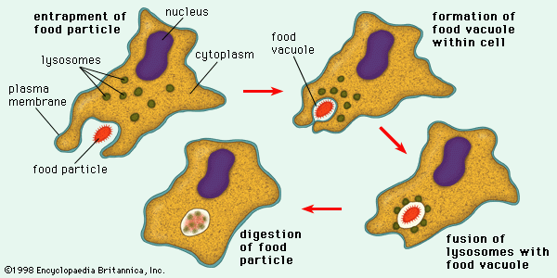
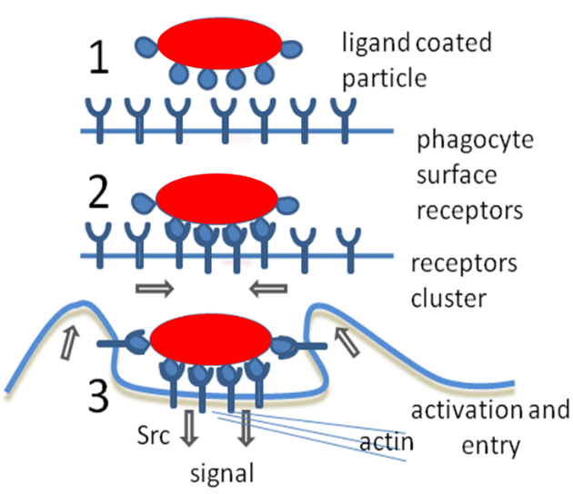
Bulk Transport across Plasma Membranes
Part II MEDICAL
Chap 16 Cell
Transport of large molecules or small particles into the cell occurs by a range of mechanisms collectively known as endocytosis (phagocytosis).
Notes:
one cleaning mechanism debris of biodegradable biomaterials.
Lysosomes are organelles containing digestive enzymes (acid hydrolases).

Slide 16
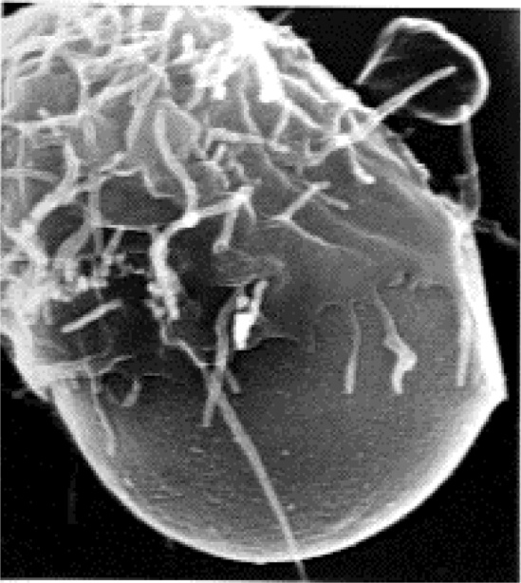
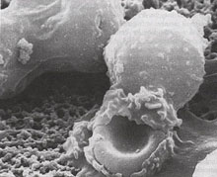
Phagocytosis
Part II MEDICAL
Chap 16 Cell
Phagocytosis is the cellular process of phagocytes of engulfing solid particles by the cell membrane.
Bacteria, dead tissue cells, and small minerals and polymer particles may be phagocytosed.
The ingested material is fused with the lysosome, leading to degradation.
Phagocytosis is one of ways that biomaterials are safely cleared from the body.
White blood cells eating
Animation:
http://highered.mcgraw-hill.com/sites/0072495855/student_view0/chapter2/animation__phagocytosis.html
Notes:
Size of cells: 20-100 micro. Can eat micro sized particles.

Slide 17
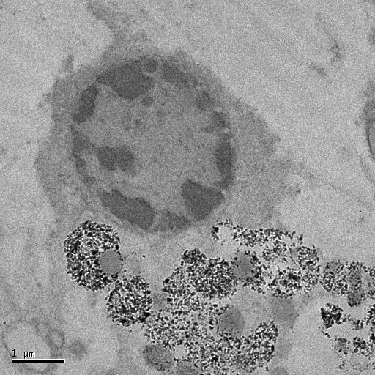
Phagocytized CaP Particles inside a Cell
Part II MEDICAL
Chap 16 Cell

Slide 18
Phagocytosis: Macrophage recruitment
Louisiana Tech University
College of Engineering and Science
From Ch. 4.3, Figure 6, Ratner et al., 2004
Notes:
Extravasation is the name of the process by which a monocytes moves through a blood vessel wall.

Slide 19
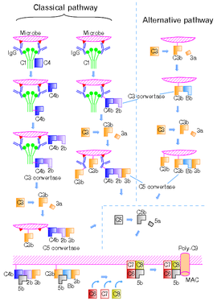
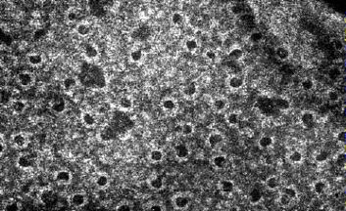
Complement System
Louisiana Tech University
College of Engineering and Science
You do not need to memorize this graphic
Some complement molecules that attach
to pathogens to mark for destruction
can adsorb onto biomaterial surfaces!
Some complement molecules form ‘membrane attack complexes’ in microbe that form pores in surface. Water enters by osmosis and microbe lyses (dies)
http://en.wikipedia.org/wiki/Complement_system
http://users.rcn.com/jkimball.ma.ultranet/BiologyPages/C/Complement.html

Slide 20
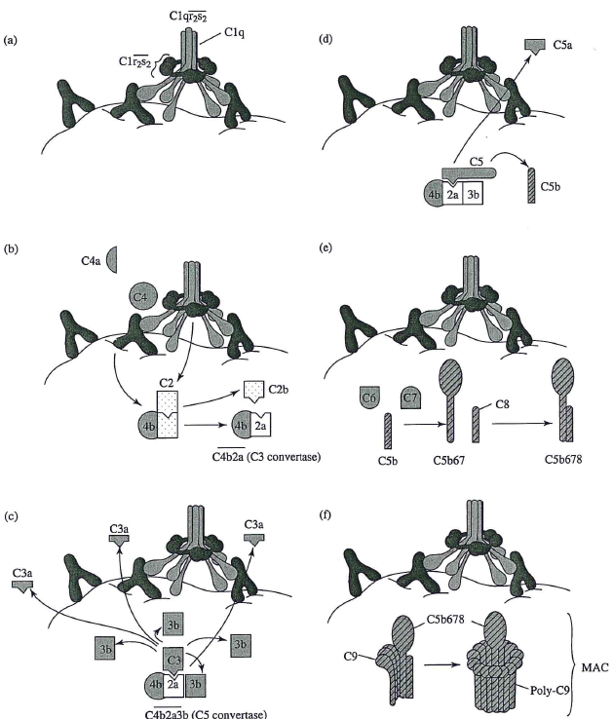
Complement molecules forming complexes on surface
You do not need to memorize graphic
Fig. 12.9, Temenoff and Mikos (2008) Biomaterials text

Slide 21
Complement system: Many processes Know (A) Opsonization … (see video on previous slide) You do not need to memorize (B) and (C).
Louisiana Tech University
College of Engineering and Science
From Ch. 4.3, Figure 5, Ratner et al., 2004

Slide 22
How are adaptive immune cells different than innate immune cells?
Louisiana Tech University
College of Engineering and Science
“In comparison [to the innate immune system], the recognition of specific antigens by the adaptive immune system is specific and unique for each potential antigen. In order to encode such a huge diversity (10⁹-10¹¹ variations), antibodies and T cell receptors (TCR) are formed by somatic recombination of different gene segments. Moreover, each T or B cell will express only a single receptor type and can therefore recognize only one antigen. Lack of response to self is controlled by a number of mechanisms (not always perfect, hence the development of autoimmune disease) ...”
(Text from FIG. 3, Ratner et al,. 2004).

Slide 23
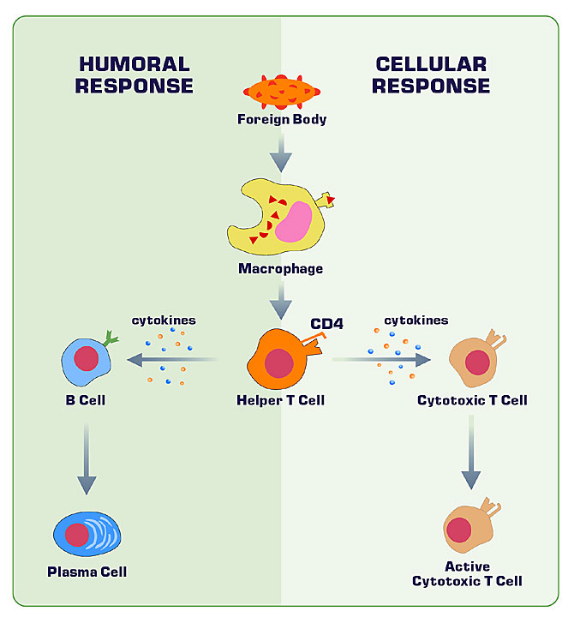
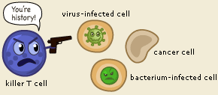
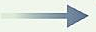
Adaptive Immune System Cells B & T Lymphocytes (B Cells & T Cells)
Louisiana Tech University
College of Engineering and Science
Antigen
Pathogen
Antigen presenting cell
Antigen (protein from infectious organism)
Animation on cytotoxic T-cells is available at:
http://www.cancerresearch.org/Resources.aspx?id=588
Y
(Th)
(Tc)
Memory B-cells
Memory T-cell
Y
Y
Y
Y
Y
Y
Y
Y
nobelprize.org
Y
Y
Also view: http://www.youtube.com/watch?v=34HovsXZ0HM&feature=related
Y
Y
Adapted from www.learner.org
Notes:
Killer T-cell killing an infected cell: http://nobelprize.org/educational_games/medicine/immunity/immune-detail.html
See an informative animation on cytotoxic (killer) T-cells from the Cancer Research Institute in New York (animation and © by Link Studios, www.linkstudios.com) at http://www.cancerresearch.org/Resources.aspx?id=588

Slide 24
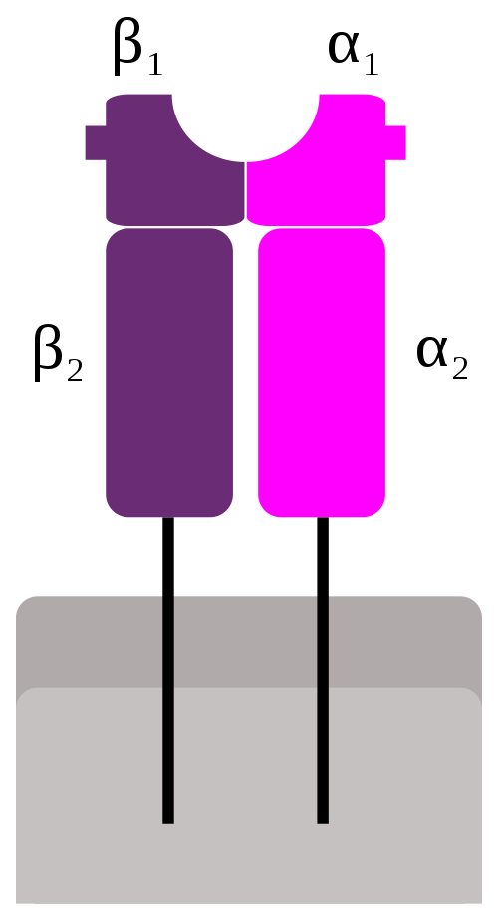
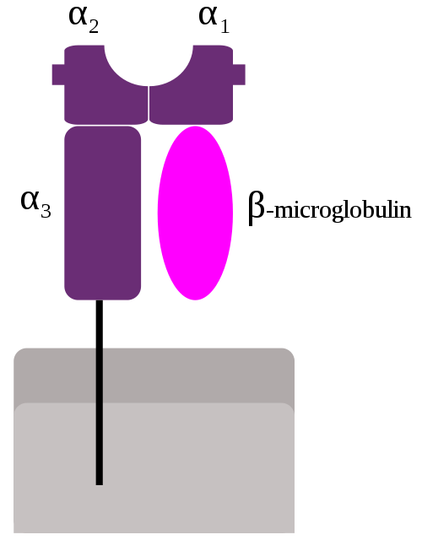
Major histocompatibility complex (MHC)
Louisiana Tech University
College of Engineering and Science
Antigen (orange)
MHC 1:
Antigen presentation to CD8+ Tc
(some subtypes also present to natural killer (NK) cells and NK T cells (NKT)
MHCII:
Antigen presentation to CD4+ on helper T cells
(Wikipedia downloaded Sept 15, 2011)
Plasma membrane
MHC Class I
(MHC I)
MHC Class II
(MHC II)
(Left) http://en.wikipedia.org/wiki/File:MHC_Class_1.svg and (Right) …File MHC_Class_2.svg

Slide 25
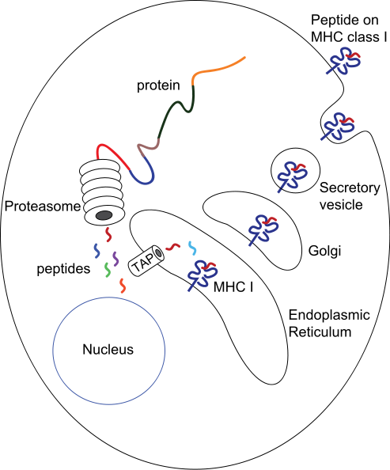
Antigen presentation and MHC I trafficking
Louisiana Tech University
College of Engineering and Science
Major histocompatibility complex (MHC) is also referred to as the human leukocyte antigen (HLA).
Phagocytic cells engulfs pathogen
Proteasome breaks down pathogen
Polypeptides from pathogen loaded onto MHC Class I molecules
MHC with particle trafficked to the cell surface.
Polypeptide-antigen I presented to receptors on T cells
T cells activated (unless the polypeptides are from “self”)
(Wikipedia downloaded Sept. 15, 2011; Ratner et al., 2004)
http://en.wikipedia.org/wiki/File:MHC_Class_I_processing.svg

Slide 26
Antigen presentation and MHC II trafficking
Louisiana Tech University
College of Engineering and Science
Phagocytic cells engulfs pathogen
Pathogen-containing endosomes fuse with lysosomes
Lysosome mediates destruction Degraded particles from pathogen loaded onto MHC II molecules
MHC II with particle trafficked to the cell surface.”
(Wikipedia cited Aderem et al. (1999) Ann. Rev. Immunol.)

Slide 27
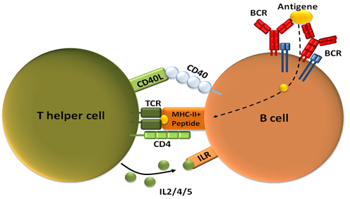
T Cells: T helper (Th) cells
Part III Interaction between implant and body
T lymphocytes are usually divided into two major subsets that are functionally and phenotypically different.
T helper (Th) cells are involved in coordination and regulation of immunological responses. They mediate responses by the secretion of cytokines that stimulate B cells to differentiate into plasma cells.

Slide 28
Lymphocytes: B-Cells and T-Cells
Part II MEDICAL
Chap 19 Body-Biomaterials
B cells act as the body's ‘military intelligence system’, seeking out their targets and tagging them with surface molecules.
T cells act as like the ‘soldiers’, destroying the “invaders”, once B-cells have identified them and have been activated after binding and signaling.

Slide 29
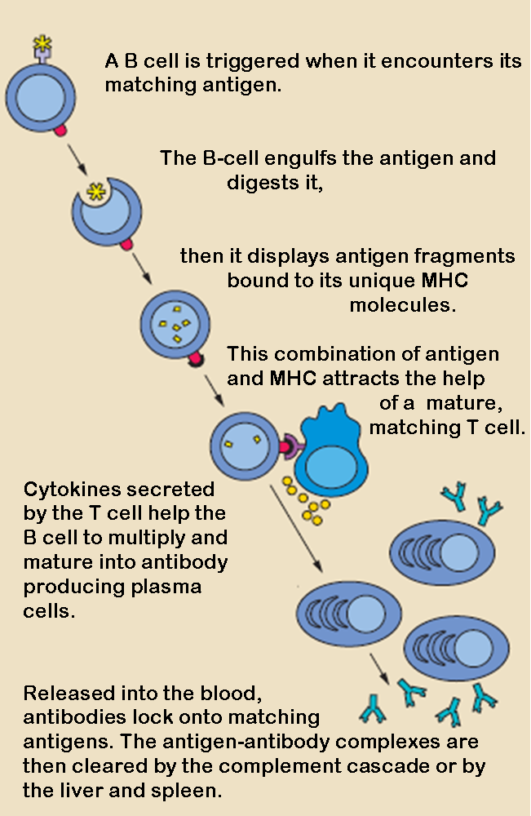
B-Cells
Part II MEDICAL
Chap 19 Body-Biomaterials
Foreign bodies (e.g. invading bacteria, cancer cells) contain surface molecules called antigens.
Following stimulation by phagocytosis of the foreign body, B-cells develop into memory B cells or antibody-secreting plasma cells.

Slide 30
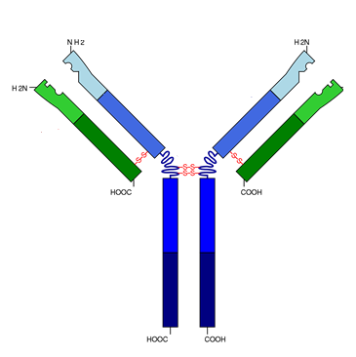
Antibody
Part II MEDICAL
Chap 19 Body-Biomaterials
Plasma cells produce a Y-shaped protein called an antibody (Ab), also known as an immunoglobulin (Ig).
Antibodies are specialized to recognize and bind to the specific antigens, which act as a tag that other leukocytes can recognise.

Slide 31
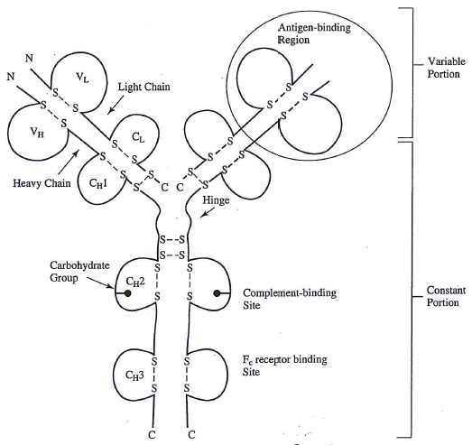
Antibody
or (F_{ab})
Variable portion is also called F_{ab} (fragment antigen binding)
Its structure is determined by rearrangement of genetic code
Specific structure leads to specific binding of epitope
Fig. 12.6, Temenoff and Mikos (2008) Biomaterials text

Slide 32
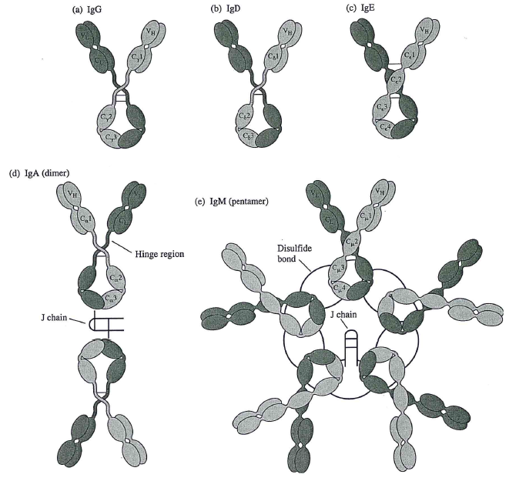
Classes of antibodies
binds up to 2 antigens
“Ig” means immunoglobulin and the capital letter after Ig identifies the class
75% are IgG
IgE are involved in allergies
binds up to 4 antigens
binds up to 10 antigens
Fig. 12.7, Temenoff and Mikos (2008) Biomaterials text

Slide 33
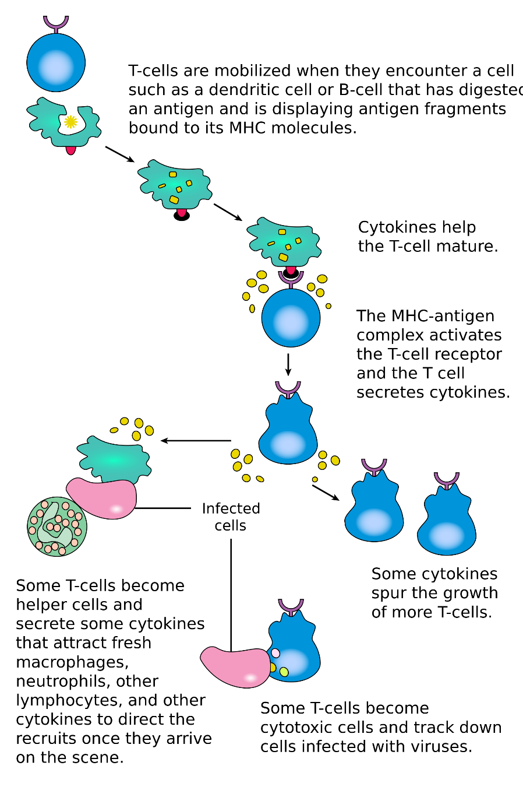
T Cells: T Lymphocytes
Part III Interaction between implant and body
Cytotoxic T lymphocytes are involved in directly killing malignant tumour cells, virus-infected cells and transplanted cells.
They basically treat these cells as not belonging to the body, and therefore the same as foreign bodies.

Slide 34
B and T Cells Work Together
Part II MEDICAL
Chap 19 Body-Biomaterials
Although B-cells recognize and tag an antigen, they are not capable of destroying it.
The job of the cytotoxic T lymphocytes (called "killer cells") is to destroy antigens that have been tagged with antibodies or cells that have been infected or somehow changed.

Slide 35
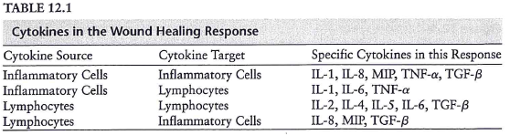
Cytokines in innate and adaptive systems
What cytokines allow the innate immune system to communicate with the adaptive immune system, and vice versa?
Know that cytokines are important signaling molecules in inflammation and wound healing. You do not need to memorize the specific numbers/names in the table.
Table 12.1, Temenoff and Mikos (2008) Biomaterials text

Slide 36
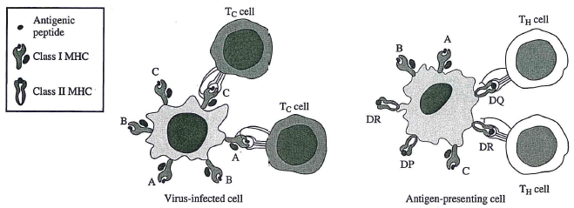
Recognition of MHC molecules by T cells
You do not need to memorize graphic
Altered self cell: (virus-infected cell or cancer cell)
Antigen presenting cell (APC)
APCs:
Macrophages
Dendritic cells
B lymphocytes
Fig. 12.3, Temenoff and Mikos (2008) Biomaterials text

Slide 37
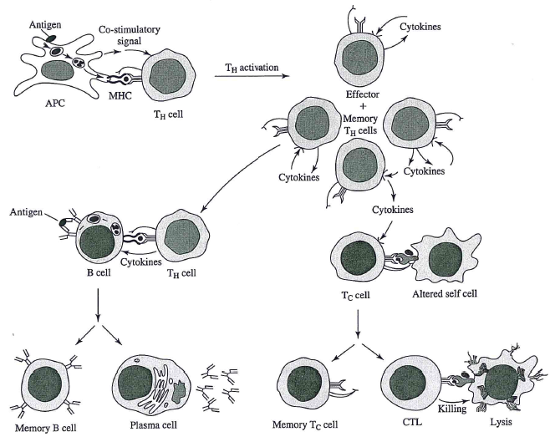
Cytokines
You do not need to memorize graphic
Cytokines
Activated cells multiply to make many cells
Adapted from Fig. 12.5, Temenoff and Mikos (2008) Biomaterials text

Slide 38
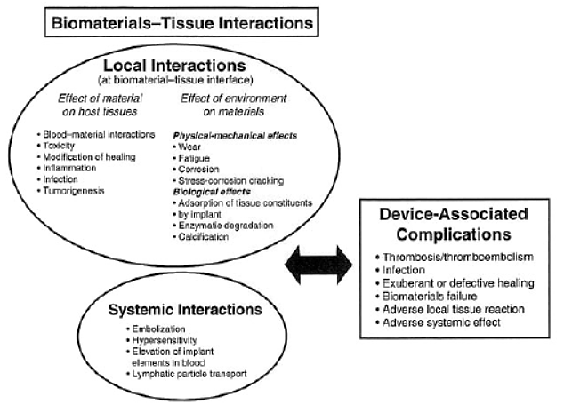

Biomaterials – Tissue Interaction
Louisiana Tech University
College of Engineering and Science
From Ch. 4.1, Ratner et al., 2004

Slide 39
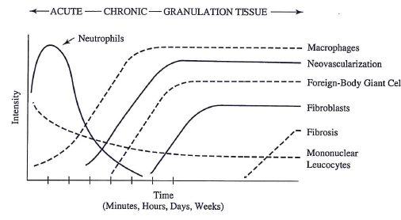
Timeline of Immune Cell Response & Wound Healing
Louisiana Tech University
College of Engineering and Science
Fig. 11.1, Temenoff and Mikos (2008) Biomaterials text
Chapter 4.2 Ratner et al. ,2004 “FIG. 1. The temporal variation in the acute inflammatory response, chronic inflammatory response, granulation tissue development, and foreign-body reaction to implanted biomaterials. The intensity and time variables are dependent upon the extent of injury created in the implantation and the size, shape, topography, and chemical and physical properties of the biomaterial.”

Slide 40
Acute inflammation
Louisiana Tech University
College of Engineering and Science
From Ratner et al., 2004

Slide 41
Chronic inflammation
Louisiana Tech University
College of Engineering and Science
From Ratner et al., 2004

Slide 42
Monocyte → Macrophage → FBGC
Louisiana Tech University
College of Engineering and Science
From Ch. 4.2 Ratner et al., 2004

Slide 43
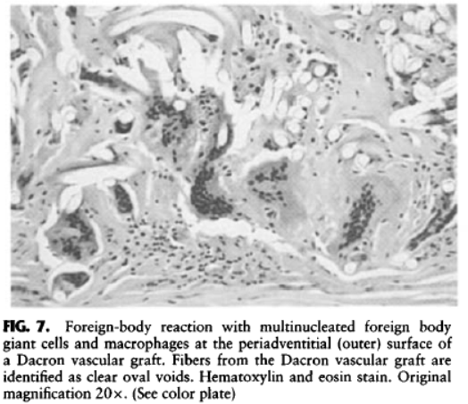
Foreign body reaction: Mulitnucleated foreign body giant cells
Louisiana Tech University
College of Engineering and Science
From Ch. 4.2 Ratner et al., 2004

Slide 44
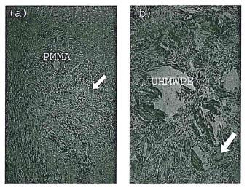
Surface texture, shape & size
Smooth or small debris:
Macrophages
Large or rough debris:
FBGCs
Fig. 11.4, Temenoff and Mikos (2008) Biomaterials text

Slide 45
Encapsulation
Louisiana Tech University
College of Engineering and Science
From Ch. 4.2, Ratner et al., 2004 “FIG. 6. (A) Focal foreign-body reaction to polyethylene wear particulate from a total knee prosthesis. Macrophages and foreign-body giant cells are identified within the tissue and lining the apparent void spaces indicative of polyethylene particulate.”

Slide 46
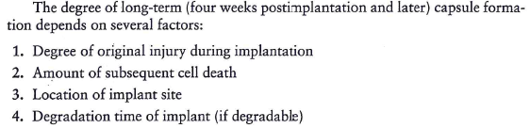
Fibrous tissue capsule
Copied from Chapter 11, Temenoff and Mikos (2008) Biomaterials text

Slide 47
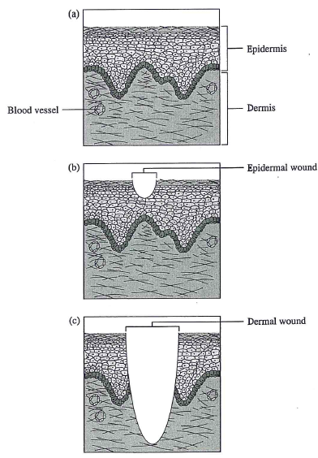
Skin repair
(b) Defect regeneration (re-epithelialization) is possible
(c) Healing is by wound repair.
Fig. 11.6, Temenoff and Mikos (2008) Biomaterials text

Slide 48
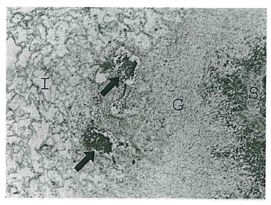
Granulation tissue
1. “Granular” appearance is from tiny buds of new blood vessels sprouting from existing blood vessels (neovascularization/ angiogenesis)
2. Proliferation of fibroblasts (forms ECM) , and some myofibroblasts (close wound)
Implant
Spleen
Granulation tissue
Vessels
Fig. 11.2, Temenoff and Mikos (2008) Biomaterials text

Slide 49
Granulation tissue formed in wound healing
Louisiana Tech University
College of Engineering and Science
From Ratner et al., 2004

Slide 50
Louisiana Tech University
College of Engineering and Science
From Ch. 4.1, Ratner et al., 2004

Slide 51
Bonus slides: In case you are interested in learning a little more about the immune system. You do not need to memorize information on the following slides.

Slide 52
Mechanisms of antibody action
Agglutination
Precipitation
Neutralization
Lysis

Slide 53
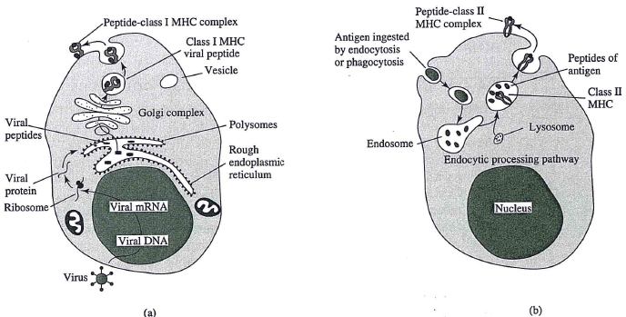
Peptide-class I or II MHC complex
You do not need to memorize graphic
Fig. 12.4, Temenoff and Mikos (2008) Biomaterials text

Slide 54
MHC I and II Pathways
Louisiana Tech University
College of Engineering and Science
You do not need to memorize table
Characteristic | MHC-I pathway | MHC-II pathway
Peptide-MHC complex | Polymorphic chain α and β2 microglobulin, peptide bound to α chain | Polymorphic chains α and β, peptide binds to both
Types of antigen presenting cells (APC) | All nucleated cells | Dendritic cells, mononuclear phagocytes, B cells, some endothelial cells, epithelium of thymus
T lymphocytes respond to | Cytotoxic T lymphocytes (CD8+) | Helper T lymphocytes (CD4+)
Origin of antigenic proteins | cytosolic proteins | Proteins in endosomes/lysosomes (mostly from extracellular medium)
Enzymes for peptide generation | Cytosolic proteasome | Proteases from endosomes and lysosomes (e.g., cathepsin)
Location of loading peptide onto MHC | Endoplasmic reticulum | Specialized vesicular compartment
Downloaded Sept. 15, 2011. http://en.wikipedia.org/wiki/Major_histocompatibility_complex

Slide 55
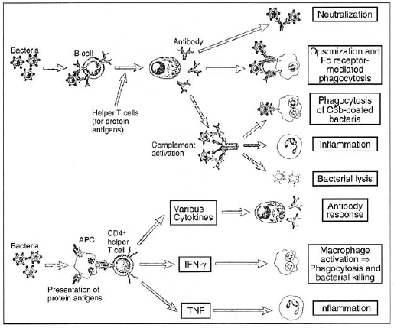
Overview of B- & T-cell responses
Louisiana Tech University
College of Engineering and Science
You do not need to memorize graphic
From Ch. 4.3, Ratner et al., 2004 “FIG. 7. T- and B-cell adaptive immune responses to extracellular microbes. Adaptive immune responses to extracellular microorganisms (and their toxins) include B-cell responses to generate antibody, and helper T-cell responses that can direct both B-cell antibody production and secondary cellular activation of macrophages and other inflammatory cells. Binding of antibodies can prevent microbes from entering host tissues (neutralization), can opsonize them for phagocytes, or can help activate complement more efficiently to increase inflammatory responses or induce microbial lysis. T-cell activation
requires that antigen presenting cells (APC, such as macrophages) degrade the microbe first and present peptide fragments. After helper T-cell activation, and depending on the nature of the cytokines that are produced, B-cell responses can be augmented, or macrophages and other inflammatory cells may be activated. IFN-y, interferon-y; TNF, tumor necrosis factor. Figure reprinted with permission from Abbas and Lichtman (2003).”

Slide 56
Louisiana Tech University
College of Engineering and Science
From Ch. 4.2, Ratner et al., 2004
Leukocytes (white blood cells)

